Slide 1
Cloud computing project K-Means algorithm in Hadoop
Maria Fabijan
Basma adawy
Francesco de vita

Slide 2
Introduction
K-means clustering is a popular algorithm for partitioning a set of data points into k clusters, where k is a given parameter. The algorithm works by iteratively assigning each point to the closest centroid and updating the centroids by taking the average of the points assigned to them. The algorithm converges when the centroids do not change significantly between iterations.
The aim of this project is to implement a framework in java for performing k-means clustering using Hadoop MapReduce.

Slide 3
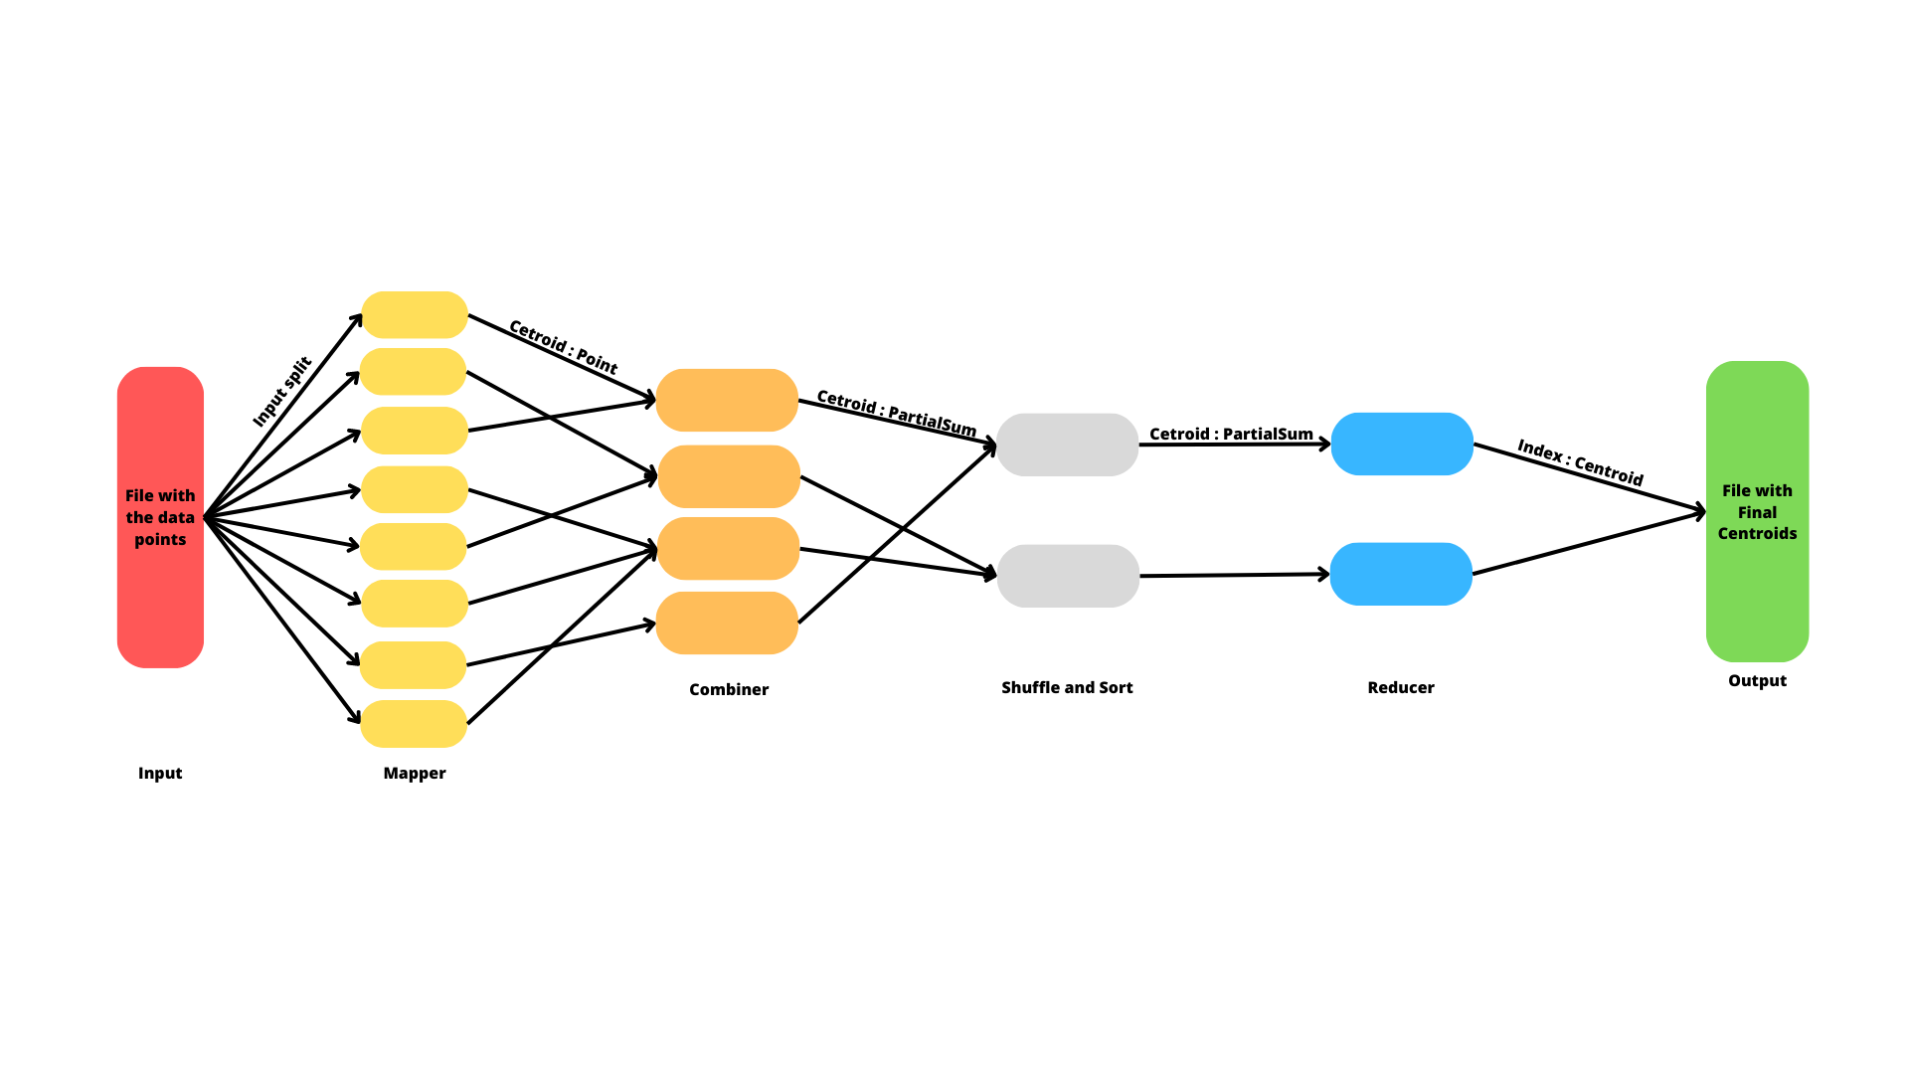

Slide 4
Mapper
The mapper’s task is to find the nearest centroid to each point in the input dataset and emit them as key-value pairs. The input of the mapper is a text file that contains the coordinates of the points, one point per line. The output of the mapper is a sequence of Centroid-Point pairs, where each Centroid is the closest one to the corresponding Point.
The mapper reads the centroids from a sequence file that contains the initial centroids or the updated centroids from the previous iteration.

Slide 5
Mapper pseudocode
Input: file with data points
Output: closest centroid (key), related to each point (value)
setup(context):
Read centroids from file and store them in a list
map(key, value, context):
Parse the value into a list of coordinates
Create a new point with the coordinates
Find the closest centroid to the point
Emit the key-value pair

Slide 6
combiner
The combiner’s task is to calculate the partial sum of the coordinates and the count of the points that are assigned to the same centroid by the mapper.
The input of the combiner is a sequence of Centroid-Point pairs, where each Centroid is the closest one to the corresponding Point.
The output of the combiner is a sequence of Centroid-Point pairs, where each Point represents the partial sum and the count of the points associated with the Centroid.
The combiner reduces the amount of data that needs to be transferred to the reducer and improves the performance of the algorithm.

Slide 7
Combiner pseudocode
Input: closest centroid (key), related to each point (value)
Output: centroid (key), the partial sum and the count of the points associated with the Centroid (value)
reduce(centroid, points, context):
Initialize a counter variable
Create a new Point object called partialSum
Iterate over the points:
Iterate over the coordinates of the points:
Update the corresponding coordinate of the partial sum by adding the current point coordinate
Increment the counter
Set the counter value in the partial sum Point object
Emit the key-value centroid (key) and the partial sum (value)

Slide 8
Reducer
The reducer’s task is to calculate the new centroids by taking the average of the points that are assigned to the same centroid by the combiner.
The input of the reducer is a sequence of Centroid-Point pairs, where each Point represents the partial sum and the count of the points associated with the Centroid. The output of the reducer is a sequence of IntWritable-Centroid pairs, where each IntWritable is the index of the Centroid and each Centroid is the updated centroid. The reducer also writes the new centroids to a sequence file and checks if they have converged to a stable position by comparing them with the old centroids.

Slide 9
Reducer pseudocode
Input: centroid (key), the partial sum and the count of the points associated with the Centroid (value)
Output: Centroid index (key), Centroid coordinates (value)
reduce(consideredCentroid, points, context):
Iterate over the points:
Iterate over the coordinates of each point:
Update the corresponding coordinate of the new centroid by adding the coordinate value
Add the number of points represented by this point to the pointsCount
cleanup(context):
Compare the old centroid with the new one with the mean distance
If the mean distance < threshold:
Emit the key-value pair

Slide 10
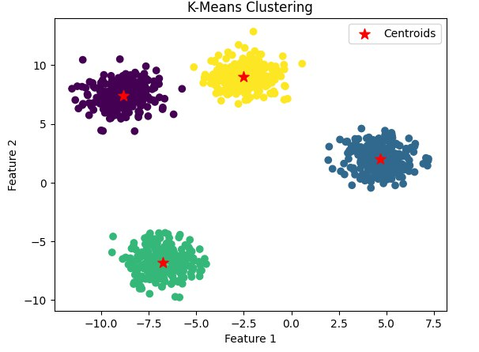
Test result
The dataset used for testing consisted of 1000 2-dimensional data points with 4 distinct clusters. For the Hadoop the threshold was set on 0.1.
Cluster number | Hadoop | Scikit-learn
0 | (4.371136957142856, 1.8467642625) | (4.65760511, 2.0269603)
1 | (-6.7391497857692295, -6.915416233230769) | (-6.74543497, -6.81351756)
2 | (-8.85662683924303, 7.413398181035851) | (-8.85662684, 7.41339818)
3 | (-2.3531666336764703, 9.13857479014706) | (-2.50173875, 9.03287546)

Slide 11
Thank you for your attention

